Slide 1
Exam INF379 - Metaheuristics
An Simulated Annealing solution to a Pickup and Delivery Problem with Time Windows
by Preben Bucher-Johannessen, pjo047
16. may 2018

Slide 2
Overview
- Main Components
- Operators
- Results
- Improvements
Main Comp – Operators – Results - Improvements

Slide 3
Main Components
(Improved) Simulated Annealing
- Cooling schedule
- Exponential curve
- Max_iterations kept low
- Cooling kept long
- Solution generation
- Generated solutions using different operators
- Operator selection
- Standard SA Acceptance Criteria
Main Comp – Operators – Results - Improvements

Slide 4
Operators
Best/First insertion
- Operator that tries to find a good(best) way to insert a call
- On failure tries to insert at a good (first) fit
Reinsert (large)
- Operator that removes x amount of calls then reinserts them
- Uses same insert method as above
Switcheroo
- Changes pickup/delivery of two calls
- Not feasible
3-Exchange
- performs a 3-swap
- Not feasible
Main Comp – Operators – Results - Improvements

Slide 5
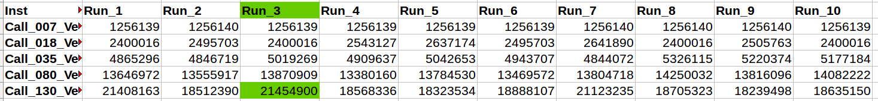
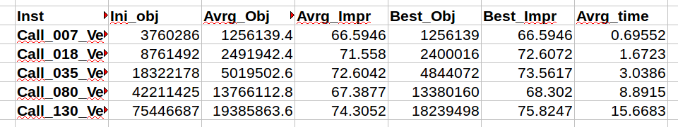
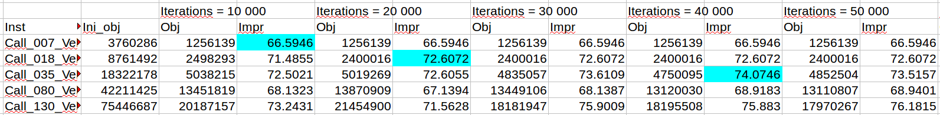
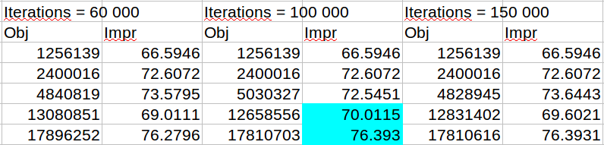
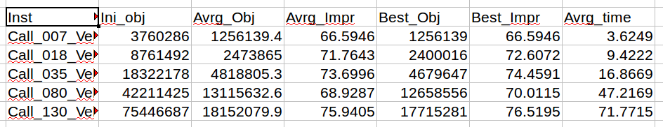
Results
Seed = 10
Iterations = 20 000
Runtime < 30 seconds
Change of iterations → Changes results
Same seed results with different iterations:
Tendency: Increased Iterations lead to more stable high results:
Iterations: 100 000
Runtime < 150 seconds
Main Comp – Operators – Results - Improvements

Slide 6
Further Improvement Possibilities
Main Components
- Adaptive model (model adapts more to the input case)
- Operator Selection
- Initial Solution generation
- Restart Algorithm
Operators
- More/better insertion methods
- Reinsertion of different sizes
- 2-Opt/3-Opt
- Swap and Exchange with feasible solutions
And so on...
Main Comp – Operators – Results - Improvements

Slide 7
Thank you for your attention…
Questions….?

